Slide 1

Alerts, Frames, Windows
Lesson - 11
Orion Innovation
Company Overview

Slide 2
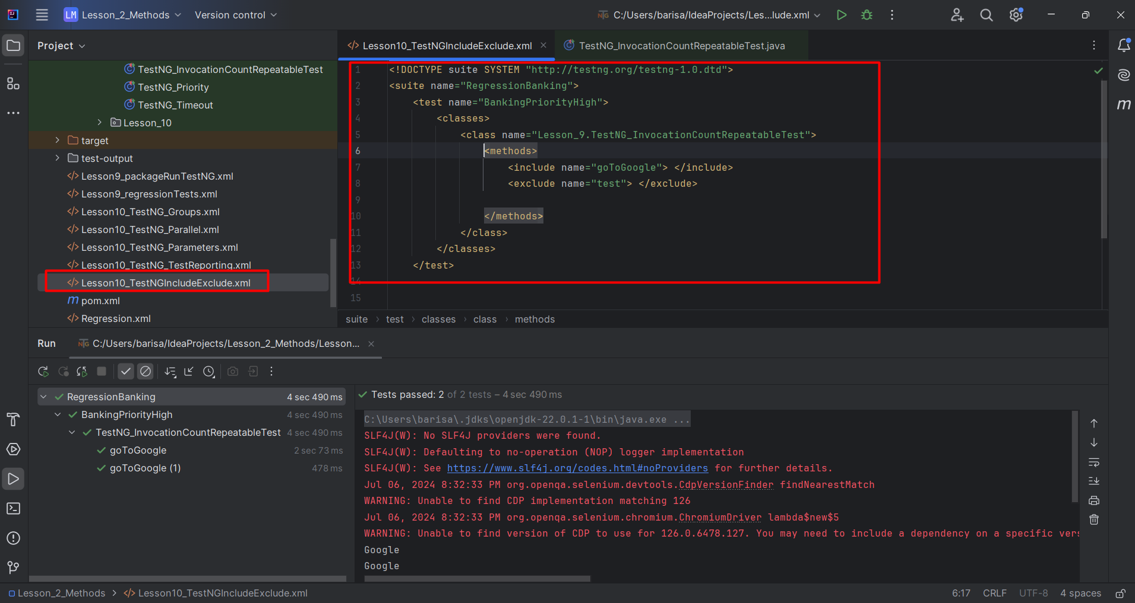
Previous Lesson’s Highlights
Include or Exclude tests on XML File

Slide 3
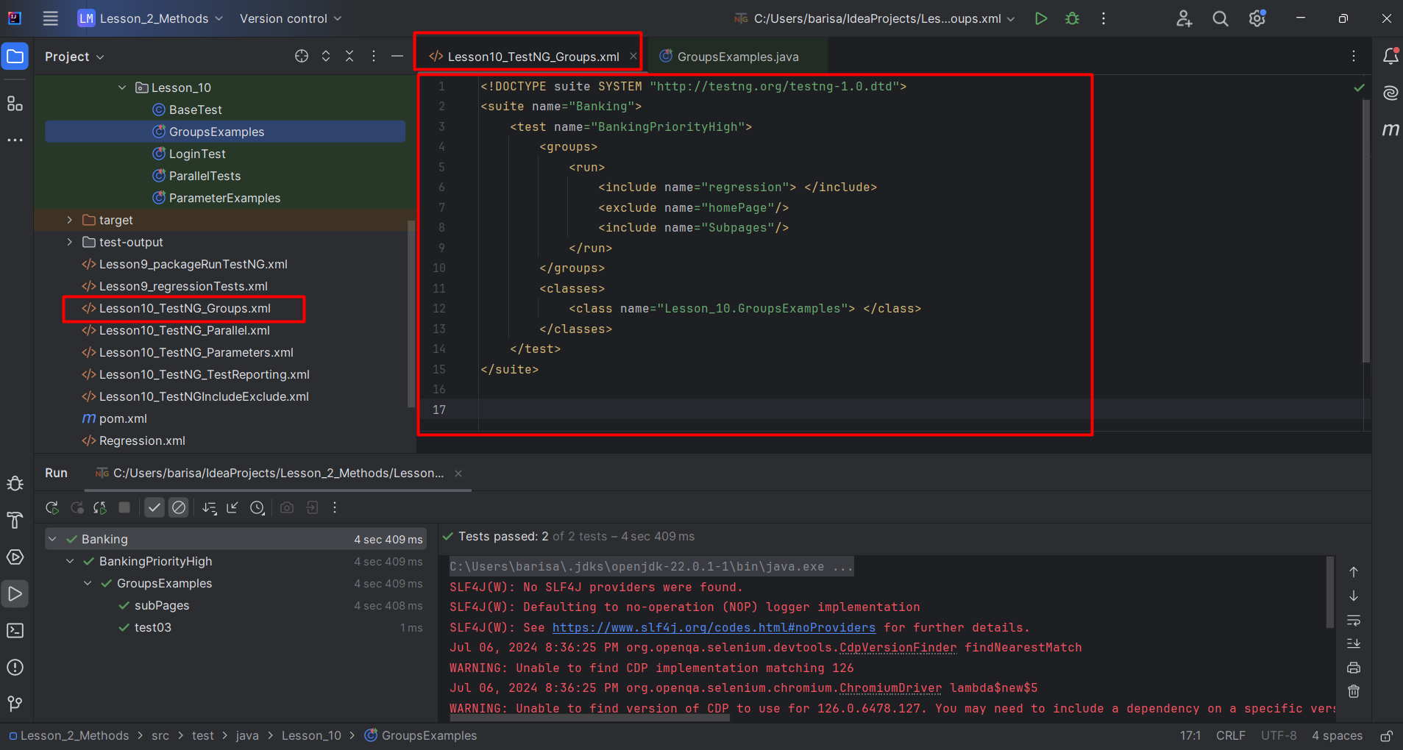
Previous Lesson’s Highlights
Test Groups on XML File

Slide 4
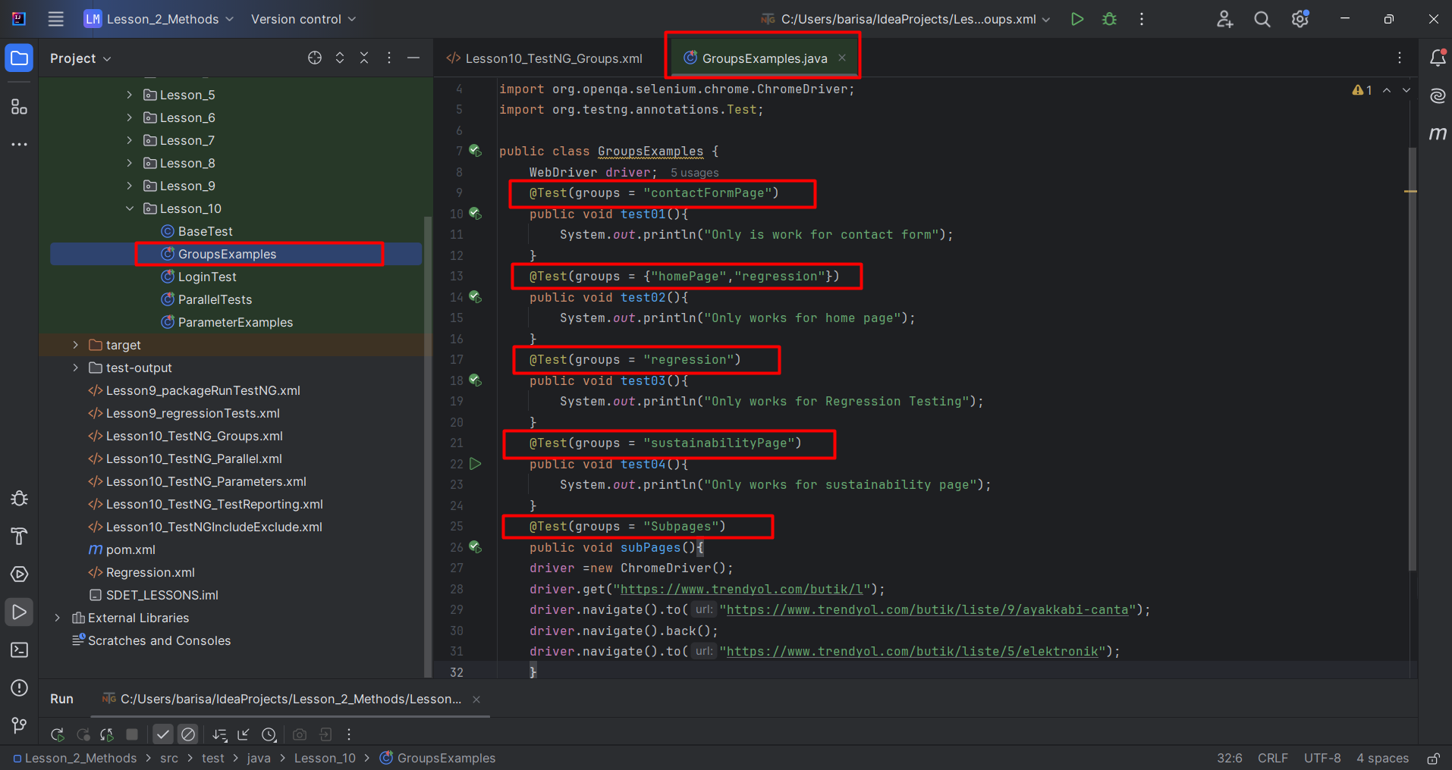
Previous Lesson’s Highlights
Test Groups Java file file: @Test(groups={“groupname1”,”groupname2”}

Slide 5
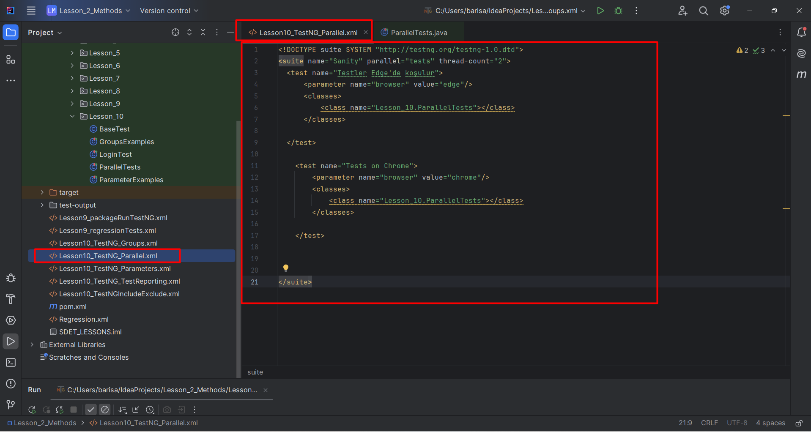
Previous Lesson’s Highlights
Parallel Testing on XML file

Slide 6
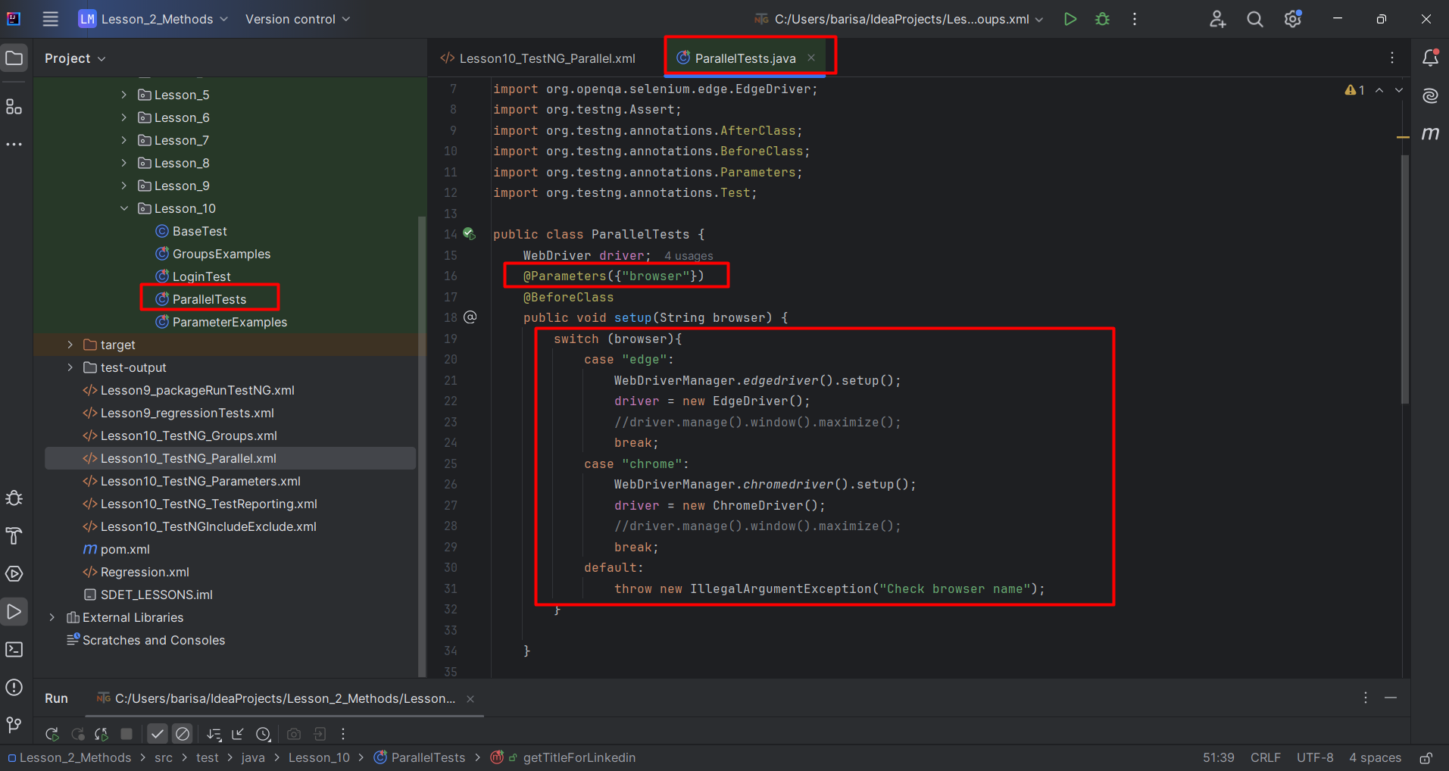
Previous Lesson’s Highlights
@Parameters({“parameterName”})

Slide 7
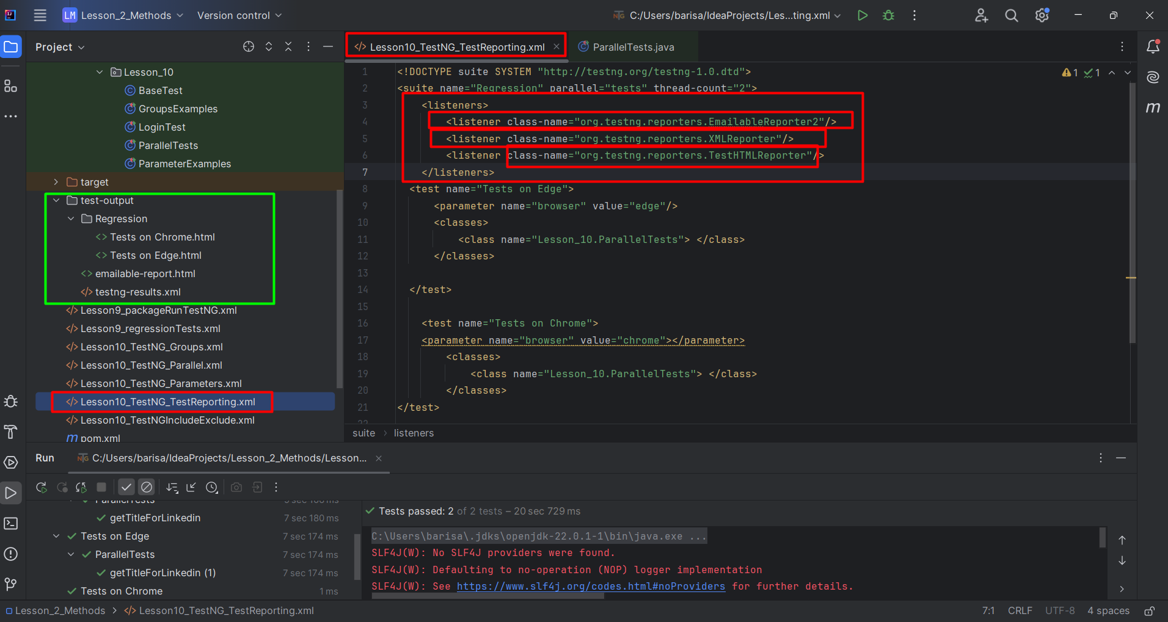
Previous Lesson’s Highlights
Test Reporting with listeners on XML File
7

Slide 8
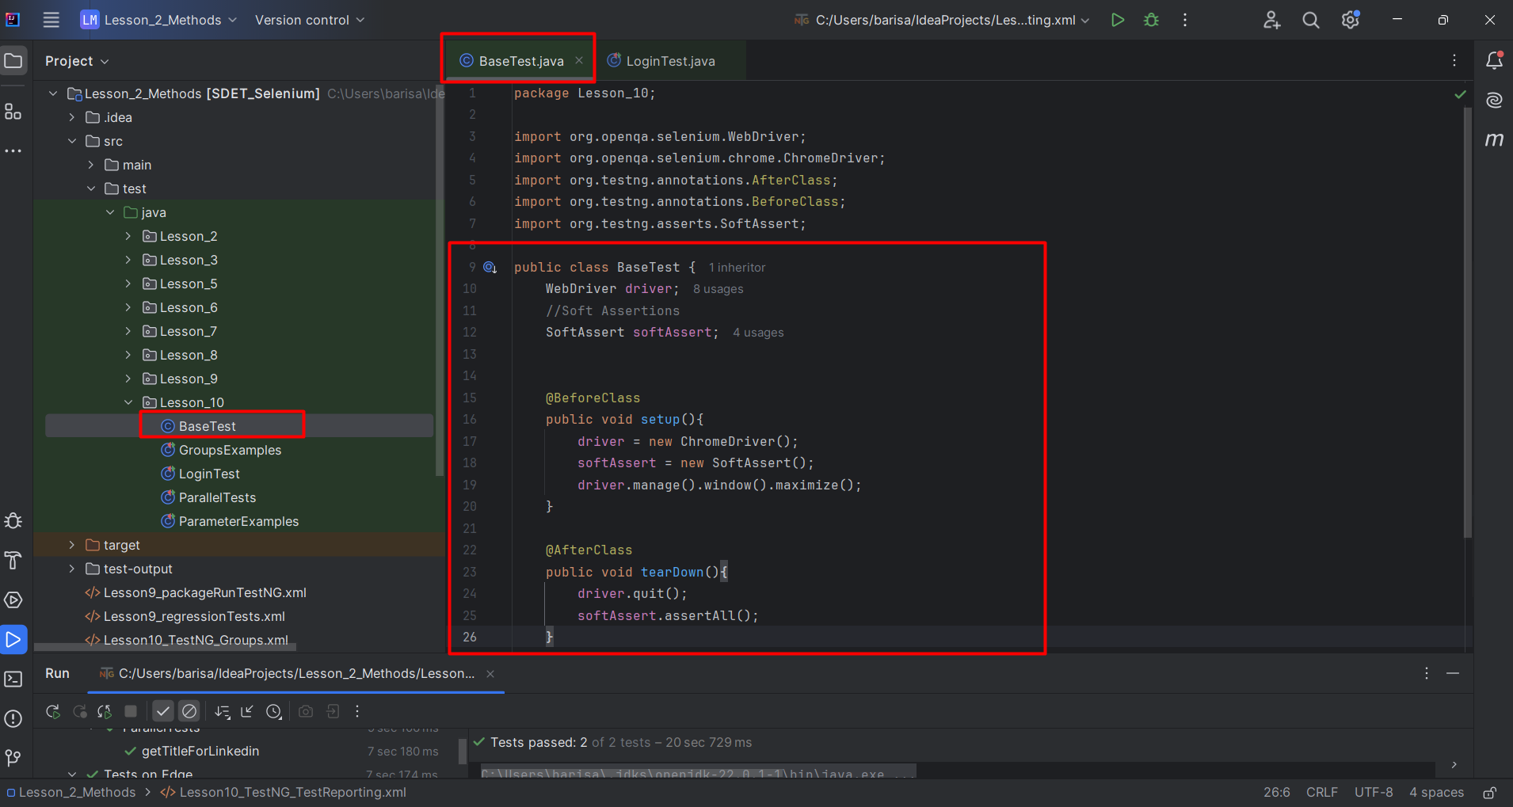
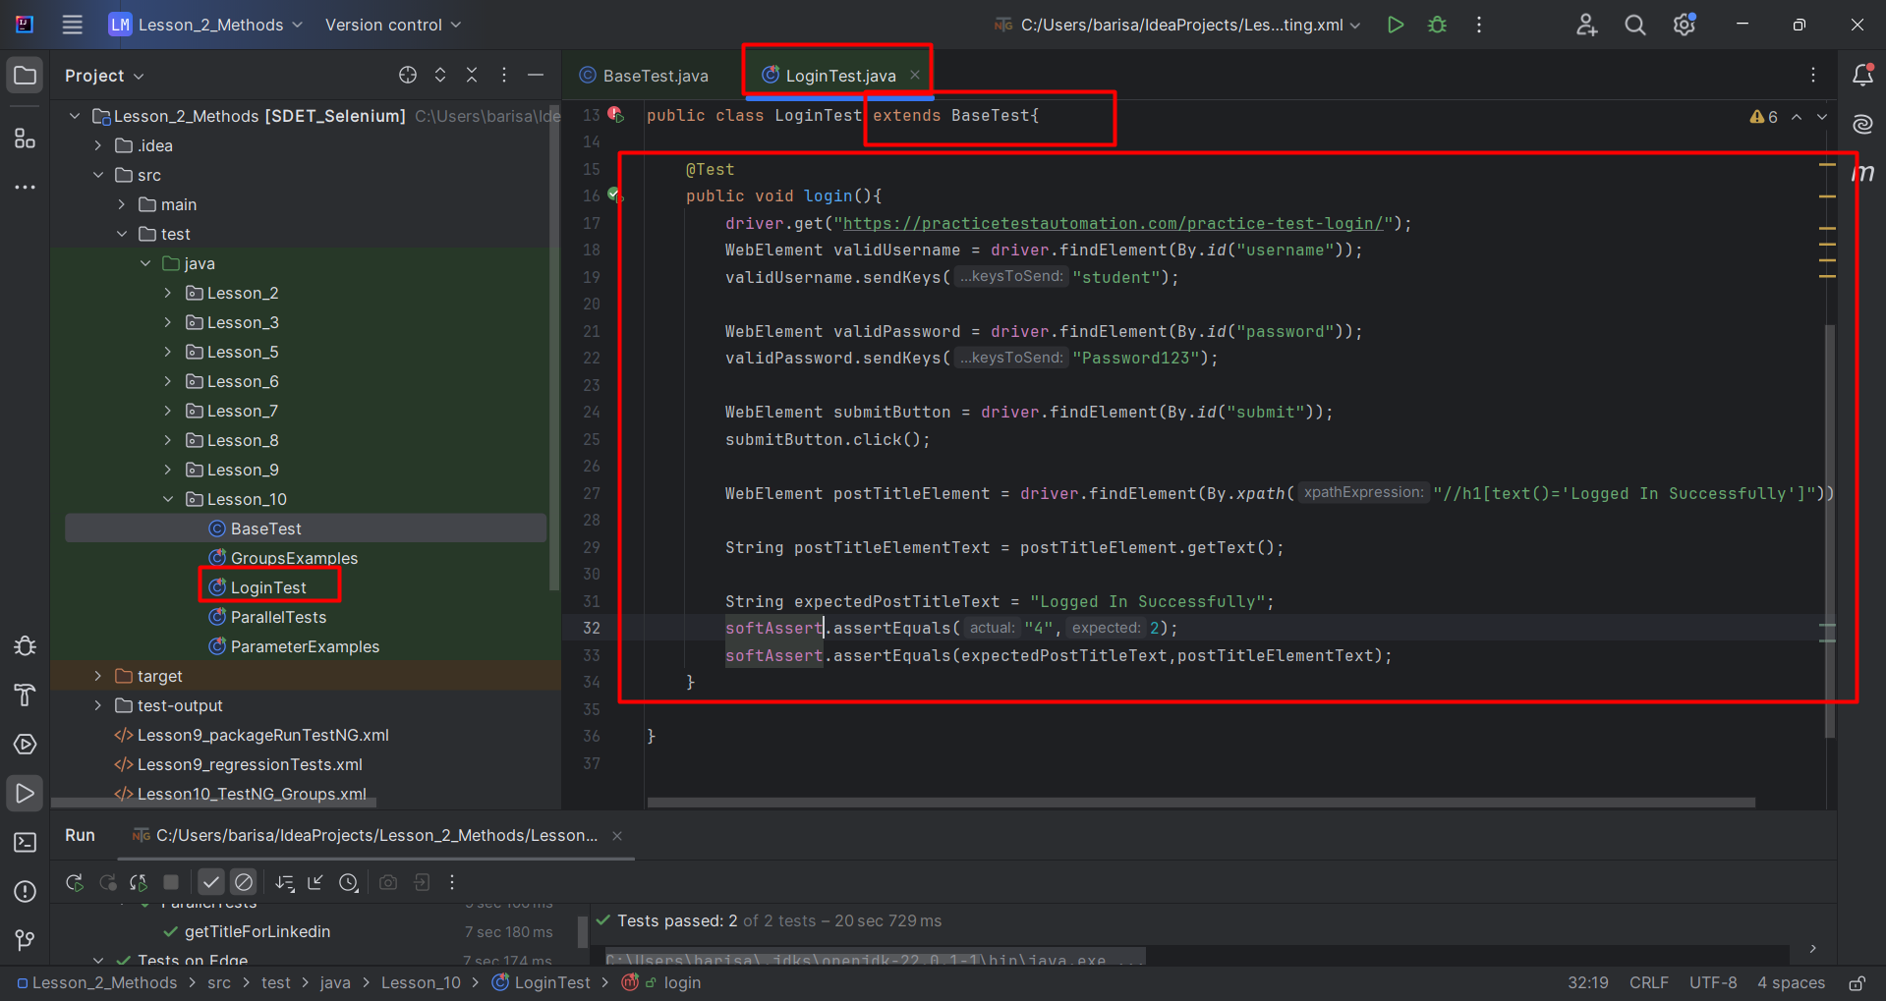
Previous Lesson’s Highlights
Base Test
8

Slide 9
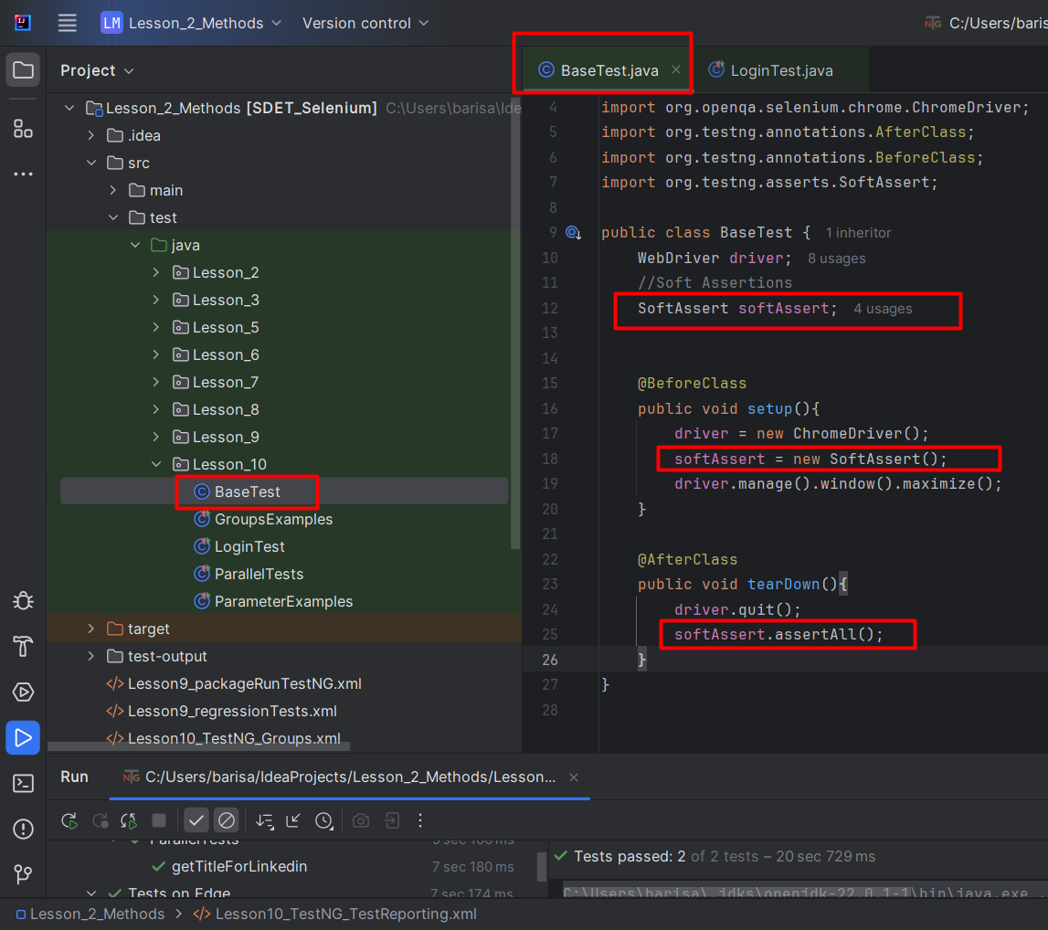
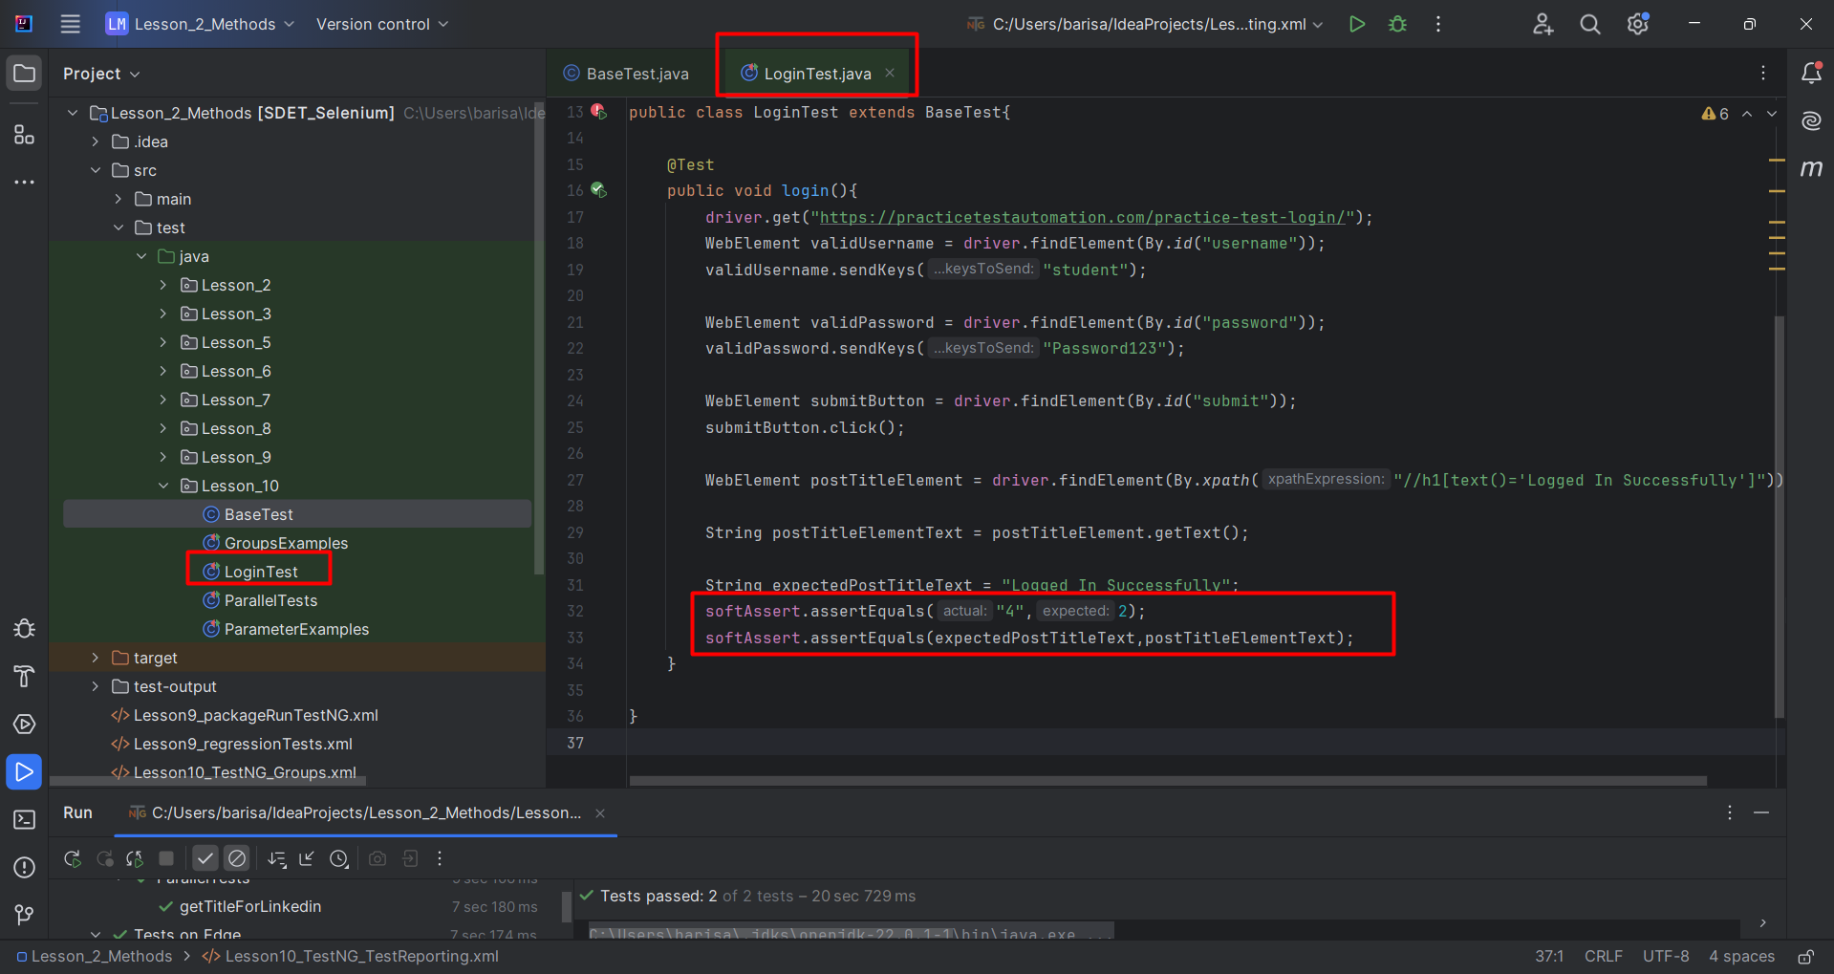
Previous Lesson’s Highlights
Soft Assertions

Slide 10
Content
Alerts
iFrames (Inline Frames)
Windows

Slide 11
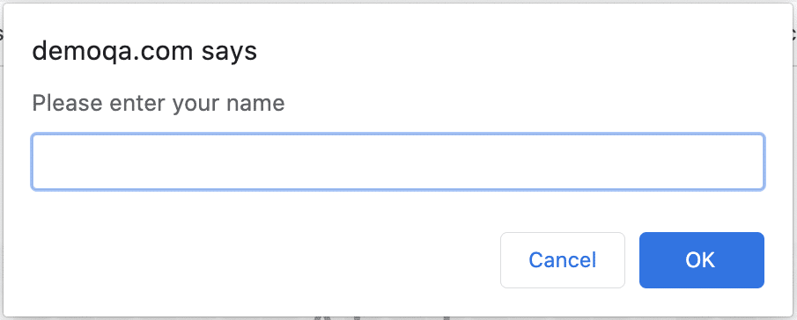
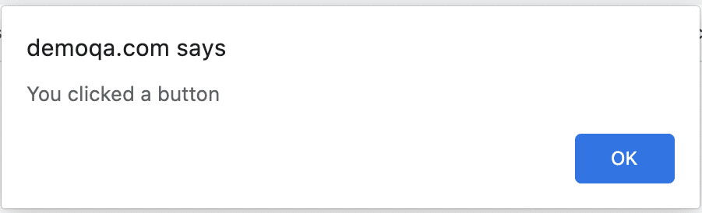
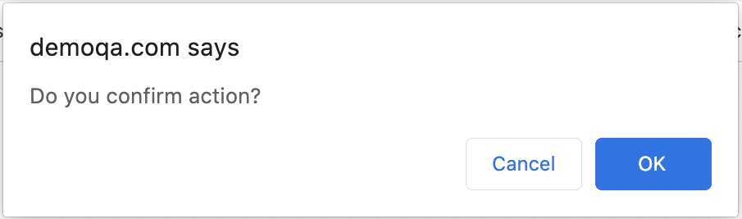
Alerts
It is a small message box which appears on screen to give the user some information or notification.
Types of Alerts in Selenium:
1) Simple Alert 2) Prompt Alert 3) Confirmation Alert

Slide 12
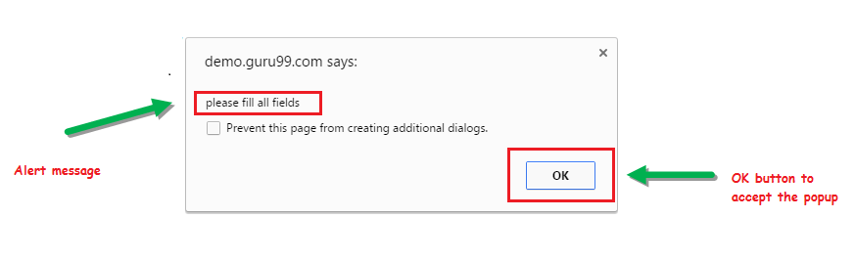
Alerts
1) Simple Alert
The simple alert class in Selenium displays some information or warning on the screen.

Slide 13
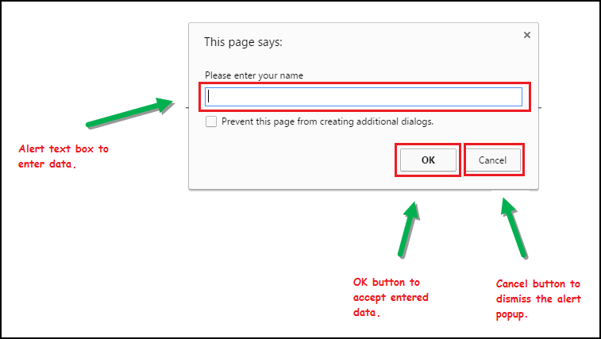
Alerts
2) Prompt Alert
This Prompt Alert asks some input from the user and Selenium WebDriver can enter the text using sendkeys(“input….”).

Slide 14
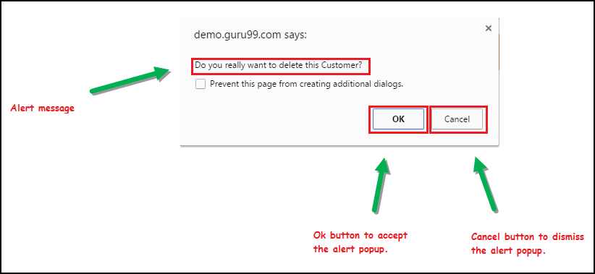
Alerts
3) Confirmation Alert
This confirmation alert asks permission to do some type of operation.

Slide 15
How to handle Alert in Selenium WebDriver?
1) void dismiss() // To click on the ‘Cancel’ button of the alert.
driver.switchTo().alert().dismiss();
2) void accept() // To click on the ‘OK’ button of the alert.
driver.switchTo().alert().accept();
3) String getText() // To capture the alert message.
driver.switchTo().alert().getText();
4) void sendKeys(String stringToSend) // To send some data to alert box.
driver.switchTo().alert().sendKeys("Text");

Slide 16
DEMO - ALERTS
https://demoqa.com/alerts
https://demo.guru99.com/test/delete_customer.php

Slide 17
iFrames (Inline Frames)
It is a web page or an inline frame which is embedded in another web page or an HTML document embedded inside another HTML document. The iframe is defined with the <iframe> tag.
<html>
<body>
<div class="box">
<iframe name="iframe1" id="IF1" height="600" width="400" src="https://toolsqa.com"></iframe>
</div>
<div class="box">
<iframe name="iframe2" id="IF2" height="600" width="400" align="left" src="https://demoqa.com"></iframe>
</div>
</body>
</html>

Slide 18
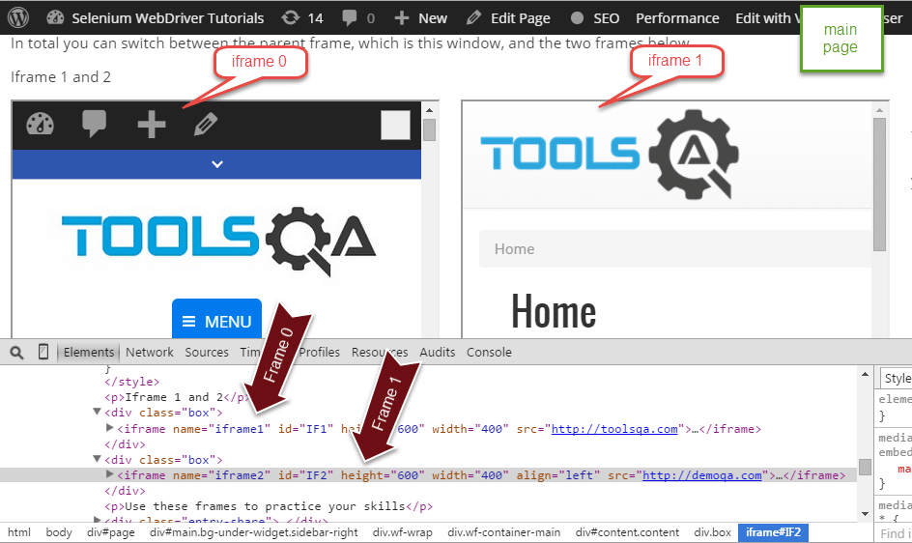
How to Handle iFrames?
By Index
By Name or Id
By Web Element

Slide 19
iFrames
By Index
Index is one of the attributes for frame handling in Selenium through which we can switch to it.
Index of the iframe starts with ‘0’.
driver.switchTo().frame(0);
driver.switchTo().frame(1);
driver.switchTo().frame(2); …

Slide 20
iFrames
By Name or Id
Name and ID are attributes for handling frames in Selenium through which we can switch to the iframe.
driver.switchTo().frame("iframe1");
driver.switchTo().frame("id of the element");

Slide 21
iFrames
By Web Element
We can even switch to the iframe using web element .
driver.switchTo().frame(WebElement);
How to switch back to the Main Frame? : We have to come out of the iframe.
To move back to the parent frame, you can either use switchTo().parentFrame() or if you want to get back to the main (or most parent) frame, you can use switchTo().defaultContent();
driver.switchTo().parentFrame();
driver.switchTo().defaultContent();

Slide 22
DEMO - iFrames
https://demoqa.com/frames
https://demo.guru99.com/test/guru99home/

Slide 23
Windows
A window in any browser is the main webpage on which the user is landed after hitting a link/URL.
Types of Windows in Selenium:
1) Main window 2) Child window

Slide 24
Window Handling Methods
getWindowHandle( ): When a website opens, we need to handle the main window i.e the parent window using driver.getWindowHandle( ); method. With this method, we get a unique ID of the current window which will identify it within this driver instance. This method will return the value of the String type.
getWindowHandles( ): To handle all opened windows which are the child windows by web driver, we use driver.getWindowHandles( ); method. The windows store in a Set of String type and here we can see the transition from one window to another window in a web application. Its return type is Set <String>.
switchto(): Using this method we perform switch operation within windows.
action: This method helps in performing certain actions on the windows.

Slide 25
References
[1] https://www.guru99.com/alert-popup-handling-selenium.html
[2] https://toolsqa.com/selenium-webdriver/alerts-in-selenium/
[3] https://www.guru99.com/handling-iframes-selenium.html
[4] https://toolsqa.com/selenium-webdriver/handling-iframes-using-selenium-webdriver/
[5] https://toolsqa.com/selenium-webdriver/window-handle-in-selenium/

Slide 26
Thanks

